Slide 1
Duval Manatee Mortality

Slide 2
9 Manatee Death Categories
Watercraft: Manatees hit by boats, barges or any type of watercraft. Death may result from propeller wounds, impact, crushing, or any combination of the three.
Crushed/Drowned in Flood Gate or Canal Lock: Manatees killed by crushing or asphyxiation in flood gates and canal locks.
Other Human-Related: Manatee deaths caused by vandalism, poaching, entrapment in pipes and culverts, complications due to entanglement in ropes, lines, and nets, or ingestion of fishing gear or debris.
Perinatal: Manatee less than 150 cm (5 ft.) in total length which were not determined to have died due to human-related causes.
Cold Stress: Manatees which die as a result of exposure to prolonged cold weather. Animals are usually emaciated and in a general state of malnutrition. (Combined with "Other Natural" in some printouts.)
Other Natural: Manatee deaths resulting from infectious and non-infectious diseases, birth complications, natural accidents, and natural catastrophes (such as red tide poisoning).
Undetermined; Too Decomposed: Manatee deaths in which the cause of death could not be determined due to an advanced stage of decomposition.
Undetermined; Other: Manatee deaths in which the carcass was in good condition (fresh or moderately decomposed), but necropsy findings were inconclusive. (Combined with "Undetermined" in some printouts.)
Verified/Not Recovered: Manatee deaths that were reported and verified, but the carcass was not available. (Combined with "Undetermined" in some printouts.)

Slide 3
2016

Slide 4
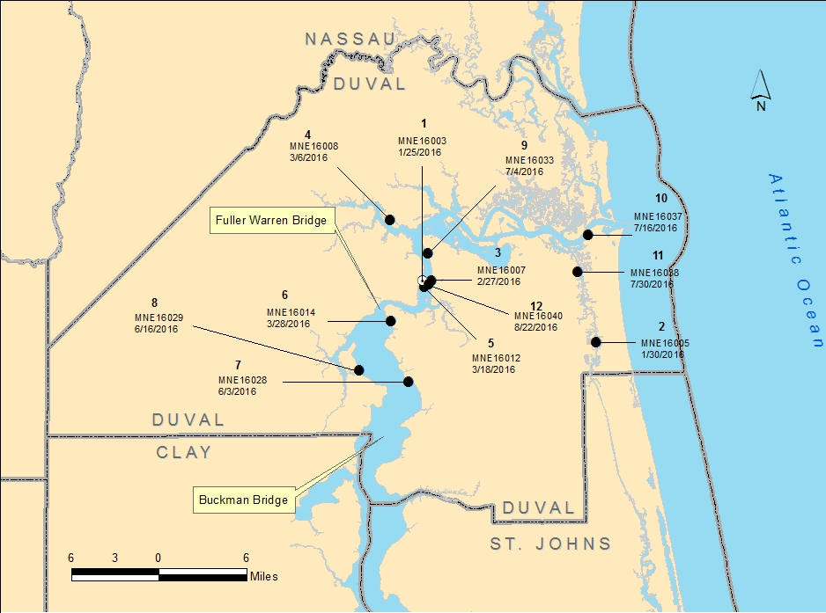
2016 Mortalities

Slide 5
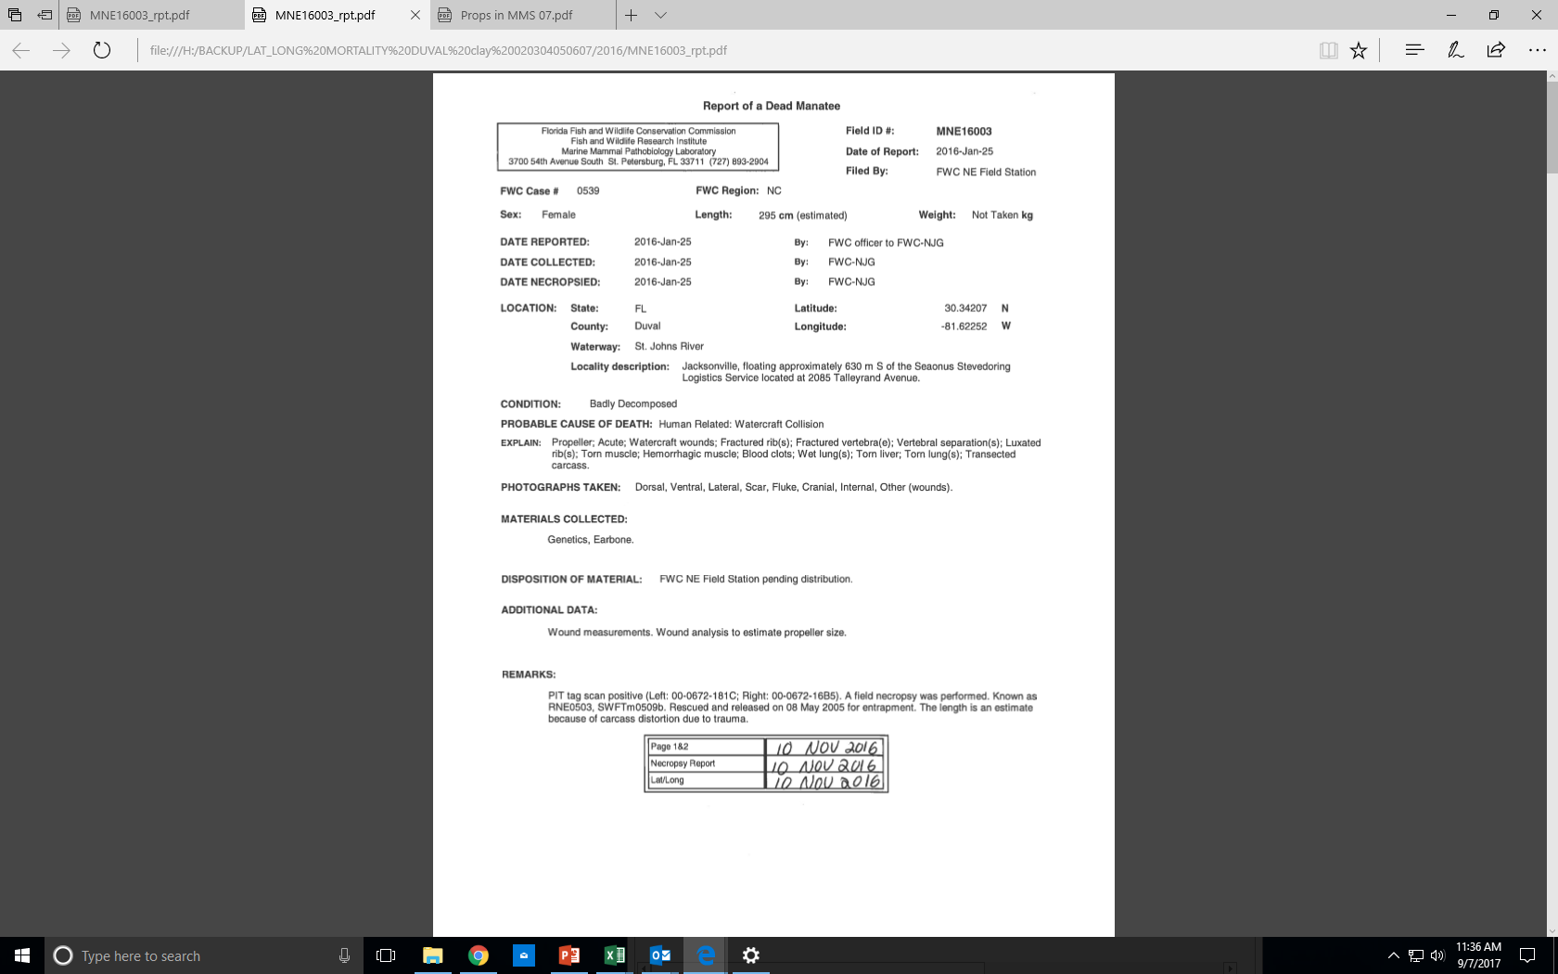

Slide 6
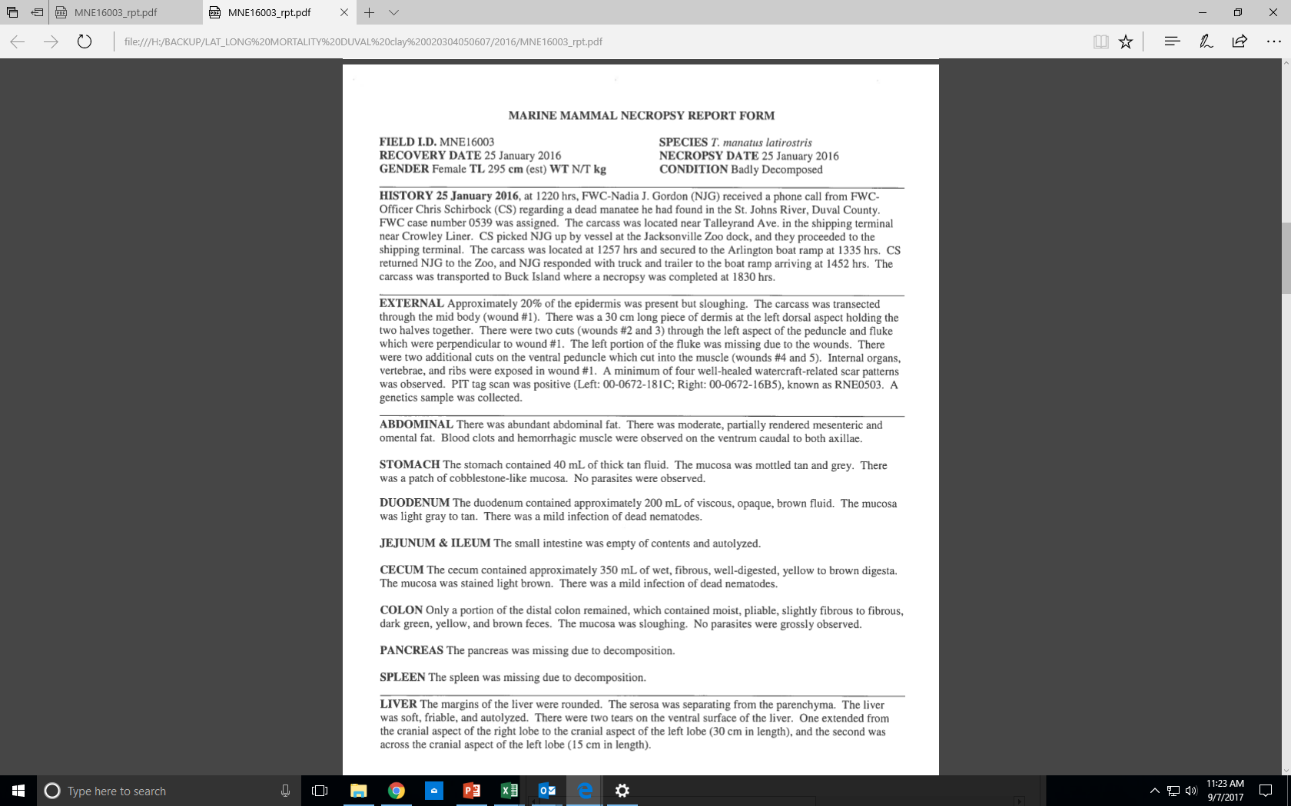
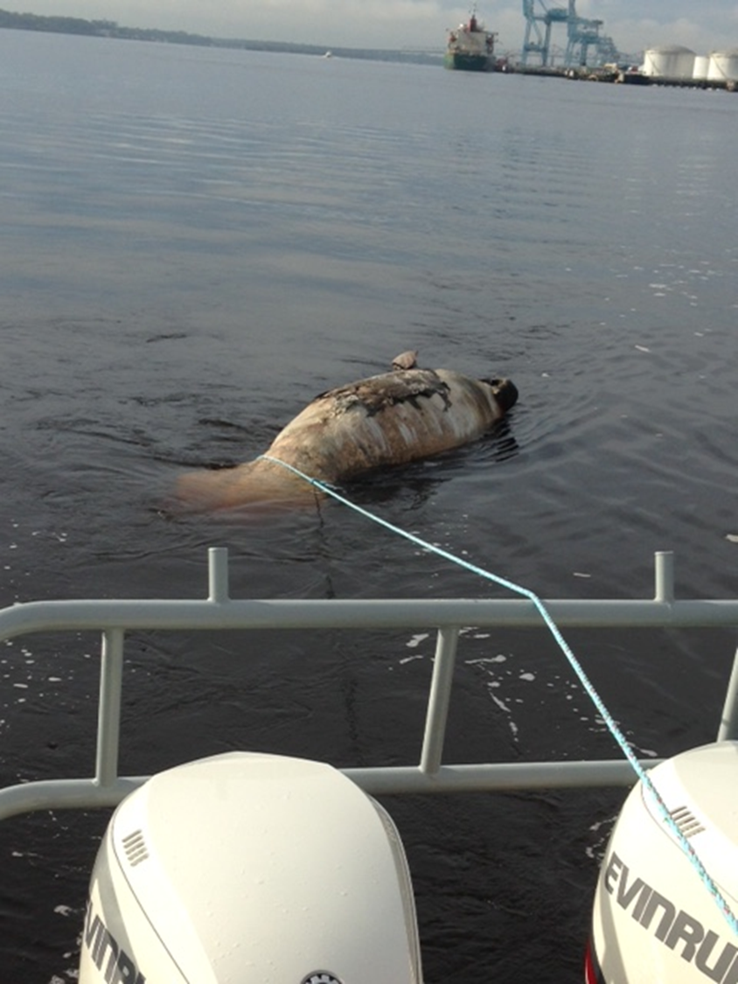
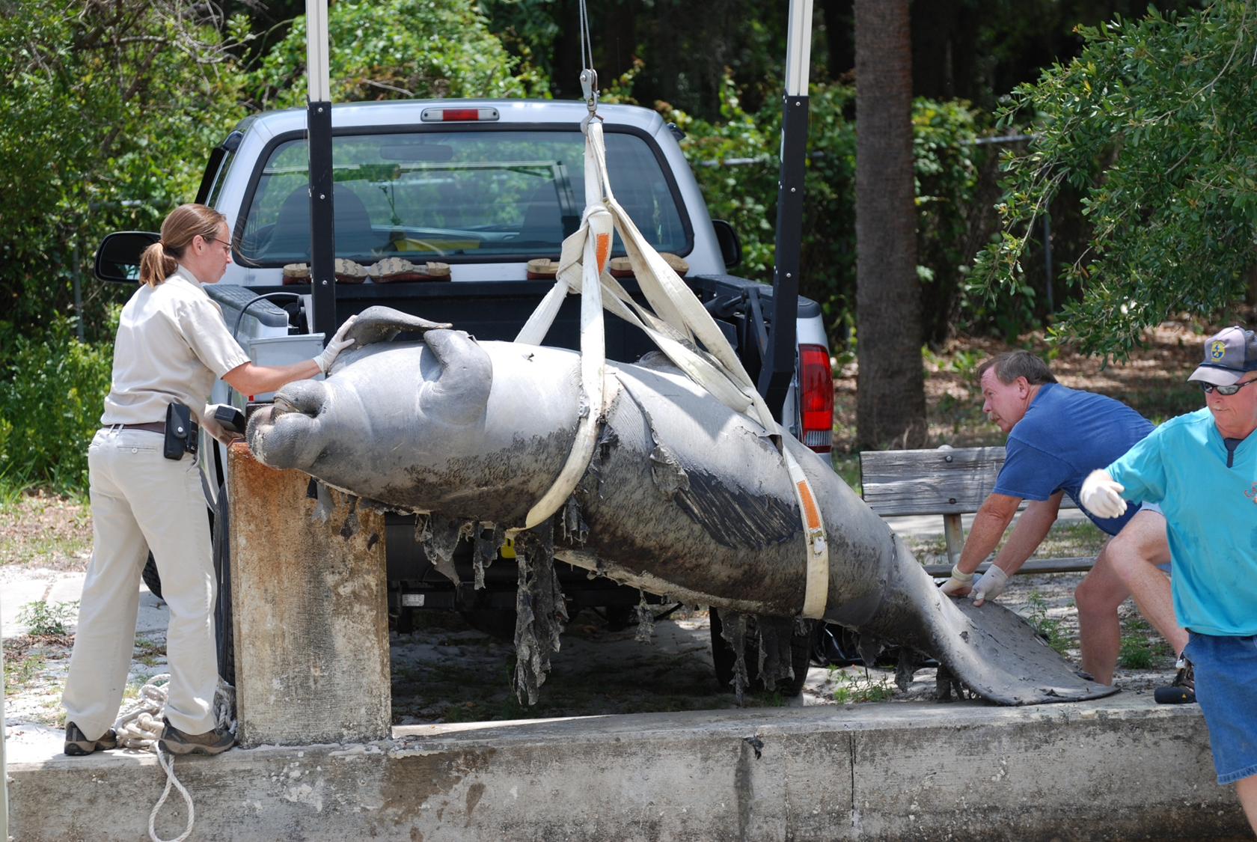

Slide 7
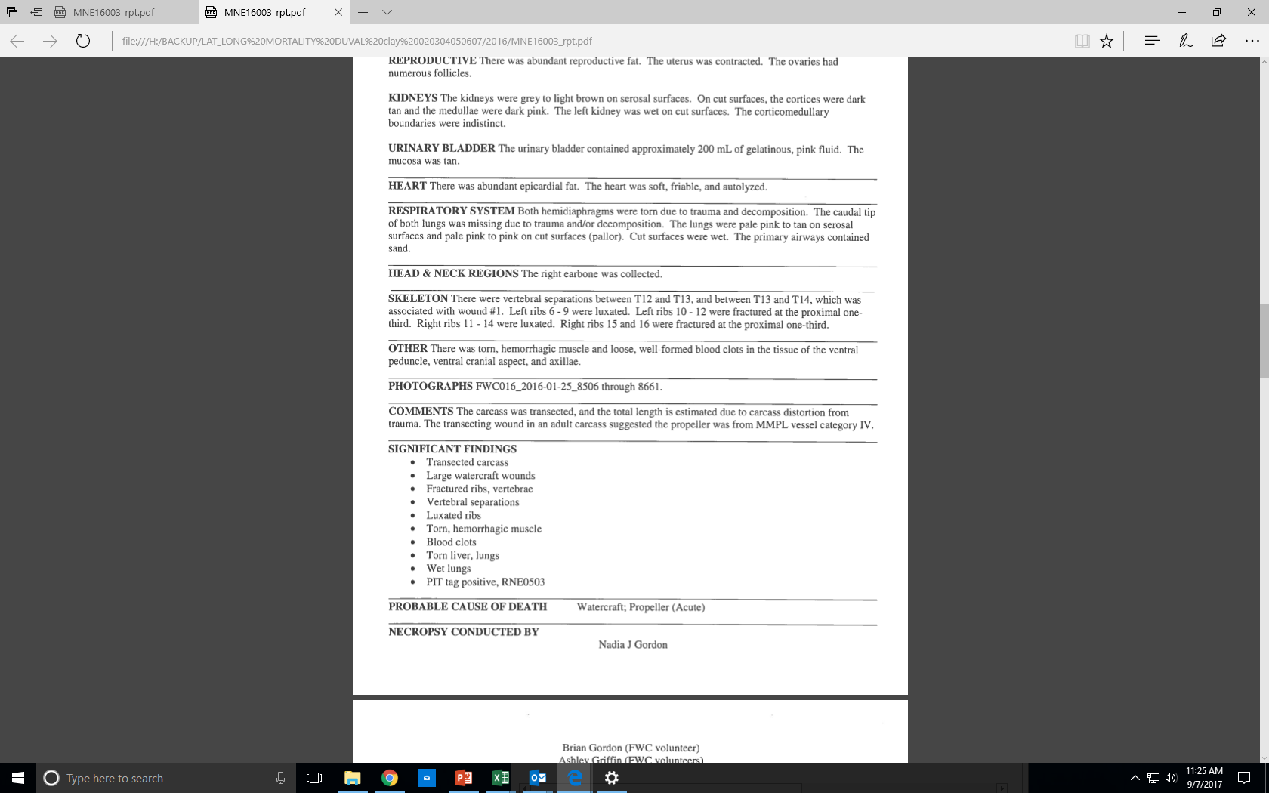

Slide 8
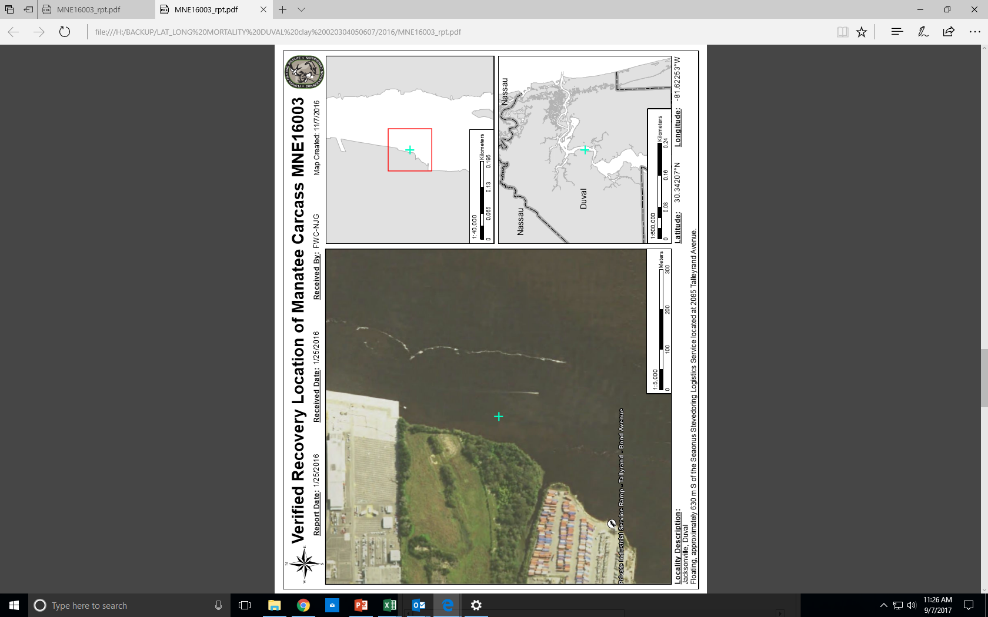

Slide 9
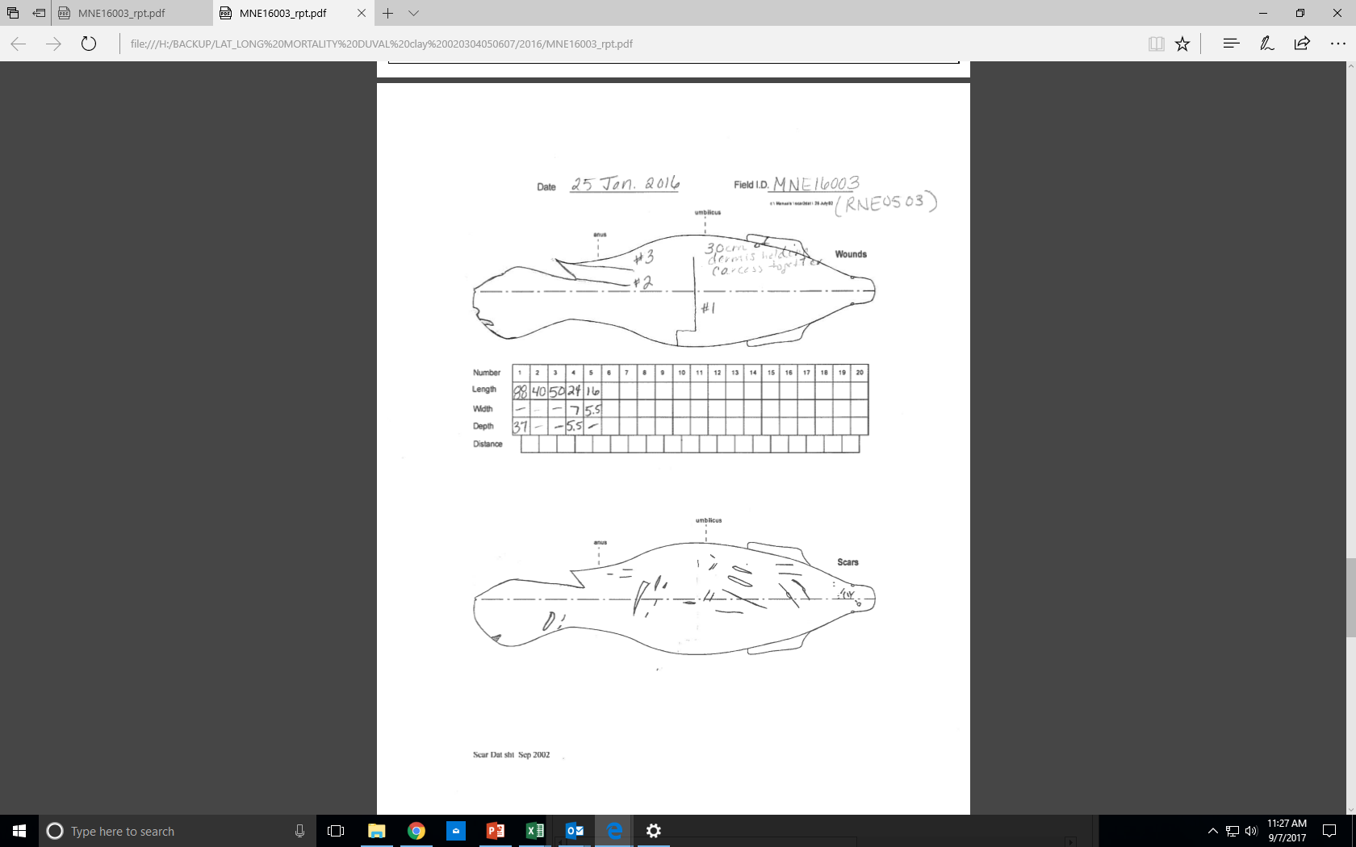

Slide 10
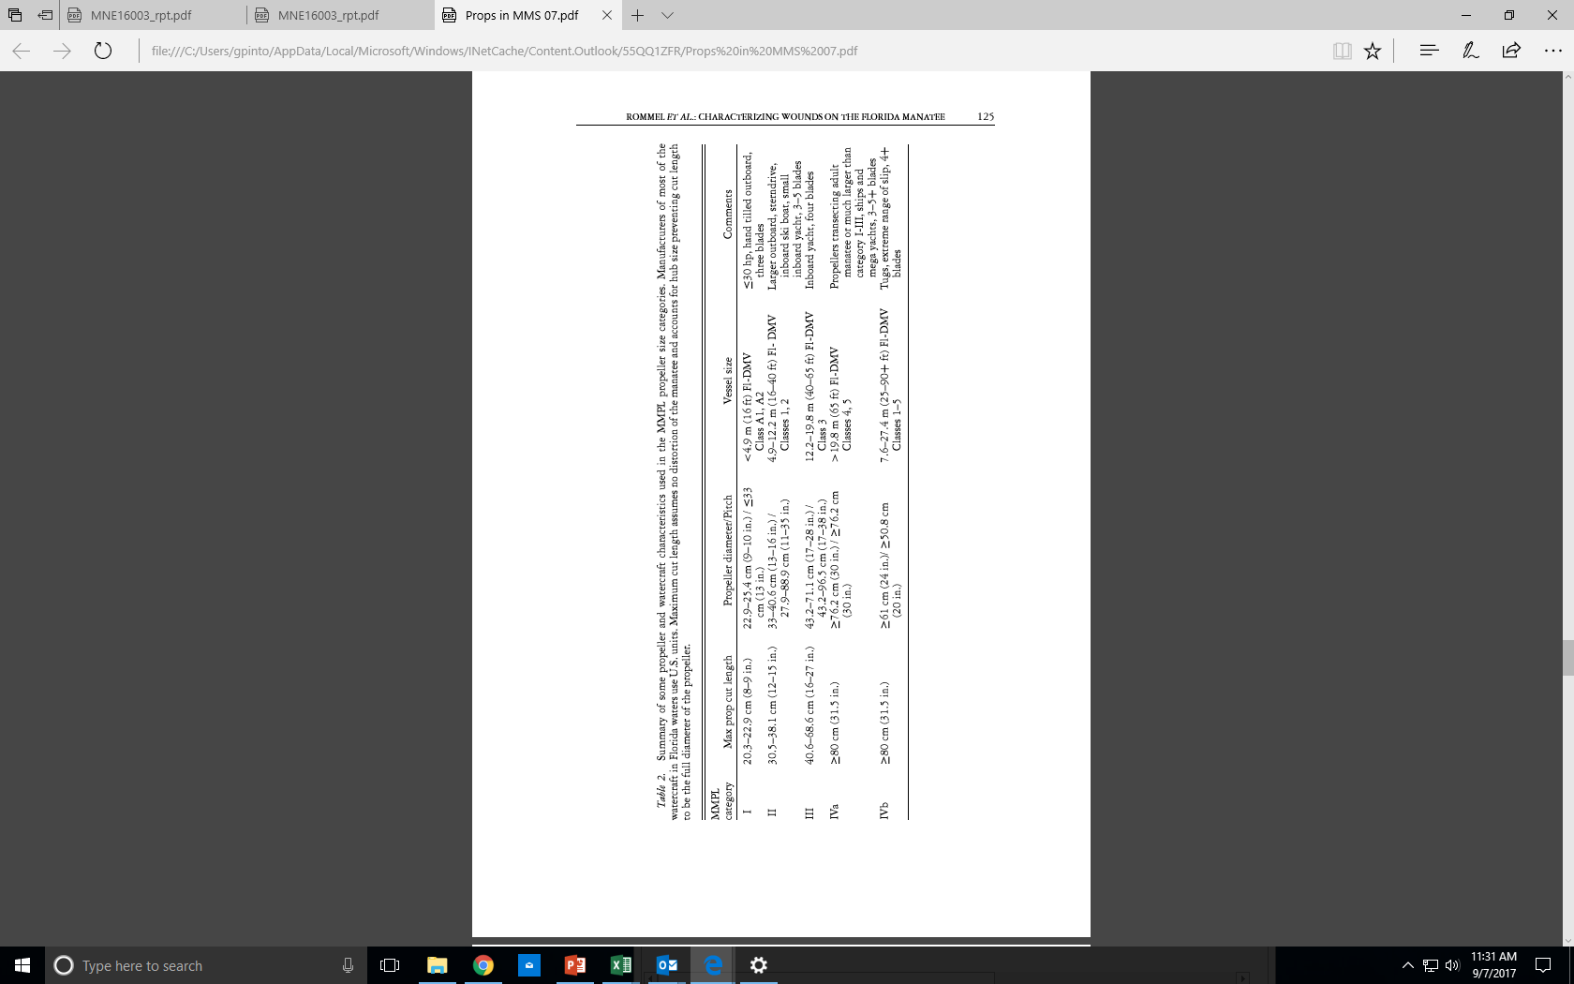
MMPL Vessel Categories

Slide 11
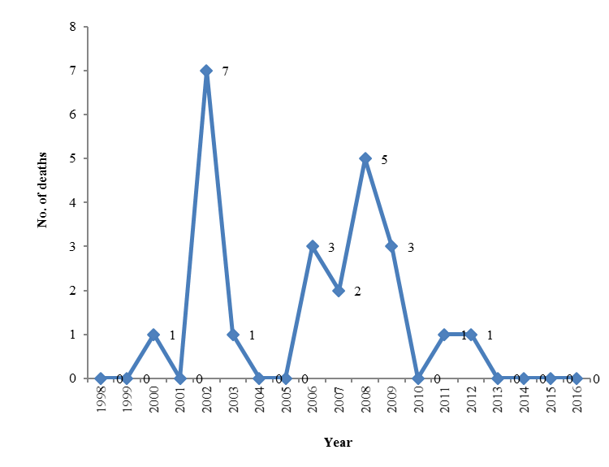
Overview of deaths from 1989 to 2017
23 total
There are 18 records prior to 2002, but they are spread from 1977 – 2001. From 2002 to the present seems to be when the estimates were done more consistently (about 1,095 records for that time frame in Florida).

Slide 12
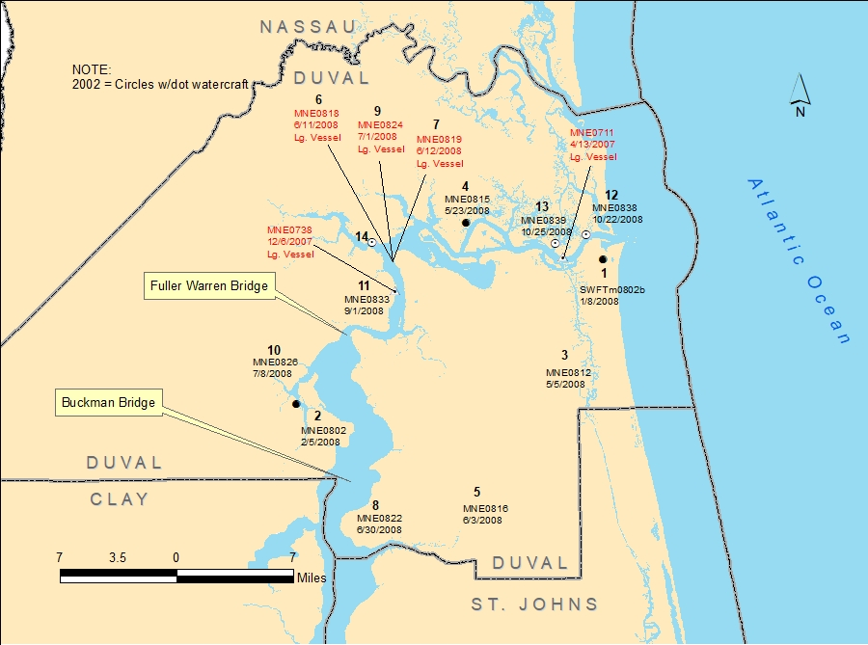
2007/08 Mortalities

Slide 13
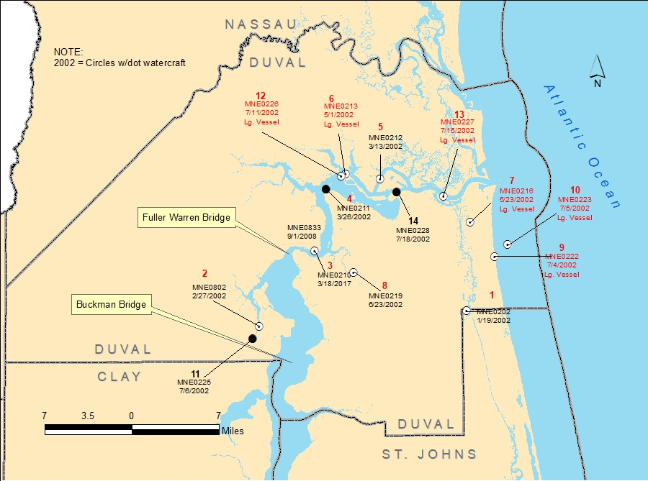
2002 Mortalities

Slide 15
MARINE MAMMAL SCIENCE, 23(1): 110–132 (January 2007) C 2006 by the Society for Marine Mammalogy DOI: 10.1111/j.1748-7692.2006.00095.x
FORENSIC METHODS FOR CHARACTERIZING WATERCRAFT FROM WATERCRAFT-INDUCED WOUNDS ON THE FLORIDA MANATEE (TRICHECHUS MANATUS LATIROSTRIS)
SENTIEL A. ROMMEL¹
ALEXANDER M. COSTIDIS
THOMAS D. PITCHFORD²
2 Florida Fish and Wildlife Conservation Commission, Fish and Wildlife Research Institute, Marine Mammal Pathobiology Lab, 3700 54th Ave. South, St. Petersburg, Florida 33711, U.S.A. E-mail: rommels@uncw.edu
JESSICA D. LIGHTSEY³
Florida Fish and Wildlife Conservation Commission, Fish and Wildlife Research Institute, Marine Mammal Pathobiology Lab, 3700 54th Ave. South, St. Petersburg, Florida 33711, U.S.A.
And
University of Florida, College of Veterinary Medicine, Marine Mammal Health Program, Gainesville, Florida, U.S.A.
RICHARD H. SNYDER PE, Recreational Boating Consulting LLC, 5326 Fond du Lac Rd, Oshkosh, Wisconsin 54902–7554, U.S.A. ELSA M. HAUBOLD4 Florida Fish and Wildlife Conservation Commission, Fish and Wildlife Research Institute, 100 Eighth Ave. SE, St. Petersburg, Florida 33701, U.S.A.
1 Current address: Biology and Marine Biology, UNCW, 601 S. College Rd., Wilmington, North Carolina 28403, U.S.A.
2 Current address: FWRI Jacksonville Field Laboratory, Jacksonville, Florida 32221, U.S.A.
3 Current address: Lightsey Veterinary Relief Services, 239 Granite Street, Paciﬁc Grove, California 93950, U.S.A.
4 Current address: Florida Fish and Wildlife Conservation Commission, 620 South Meridian Street, Mail Station 10, Tallahassee, Florida 32399, U.S.A.

Slide 16
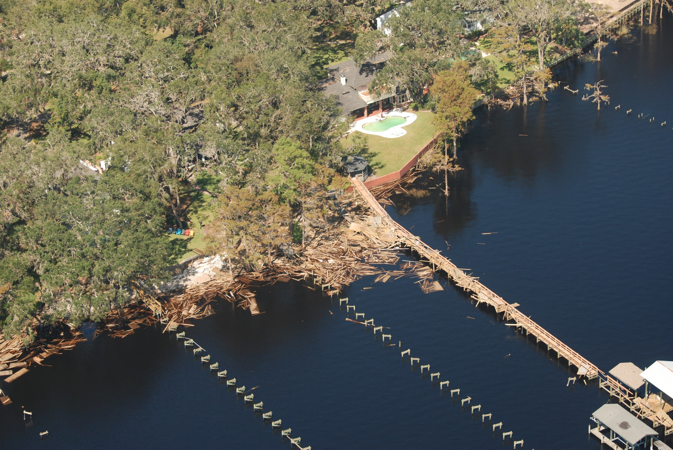
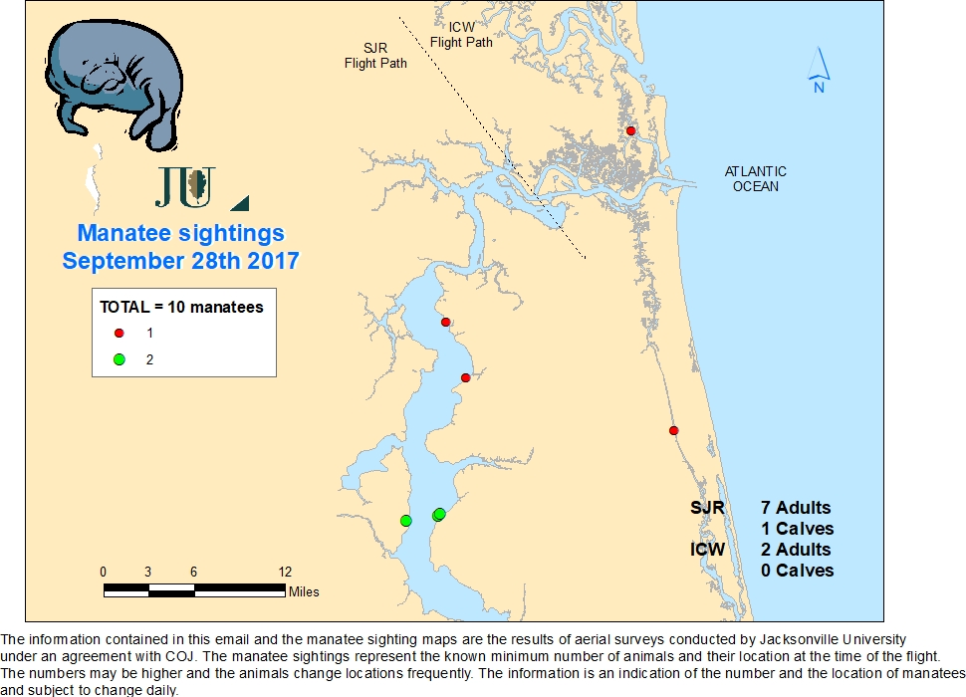

Slide 17
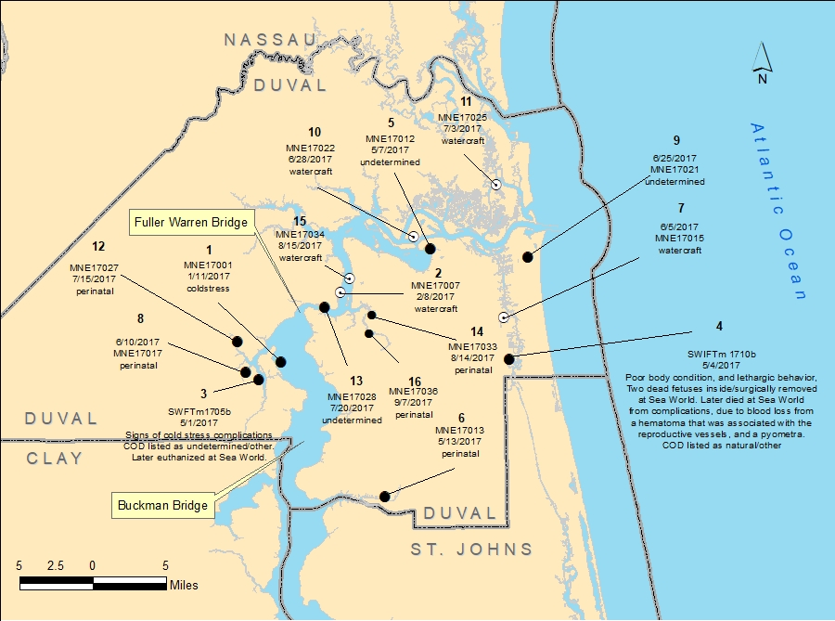
2017 Mortalities

